Slide 1
Excel Project Report
Arti agrahari

Slide 2
Problem Statement
One of India's top most cosmetic product company has a wide range of sales spread across different parts of the country. The given data is the sales record of approximately ​3 years​. Analyze the data for some​ good actionable insights which can increase their demand planning, warehouse planning, pricing of products which in turn can increase their revenue.
Source of Data: Kaggle

Slide 3
Summary
Get the top revenue contributing products.
Continuing with the above point, know where else their sales can be improved.
Analyze for their trend and seasonality factors which can give some insights about the product’s sales behavior.
Analyze the products which cannibalize each other's sales.
Analyze the pricing of products and its effect on net sales.
Project & Video link

Slide 4
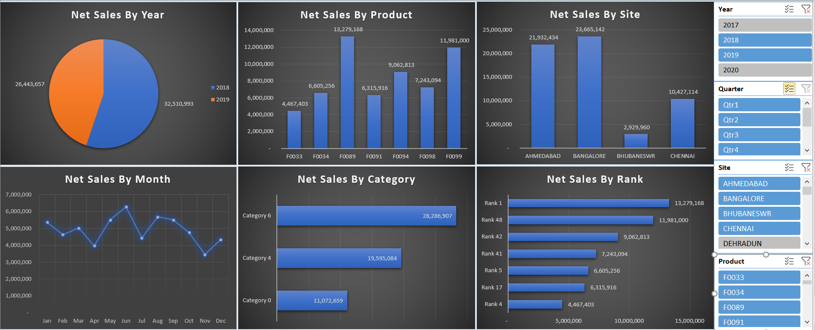
Net Sales Analysis

Slide 5
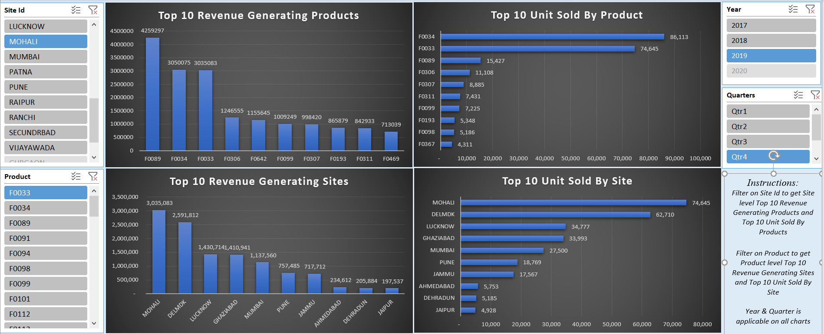
Inventory Analysis

Slide 6
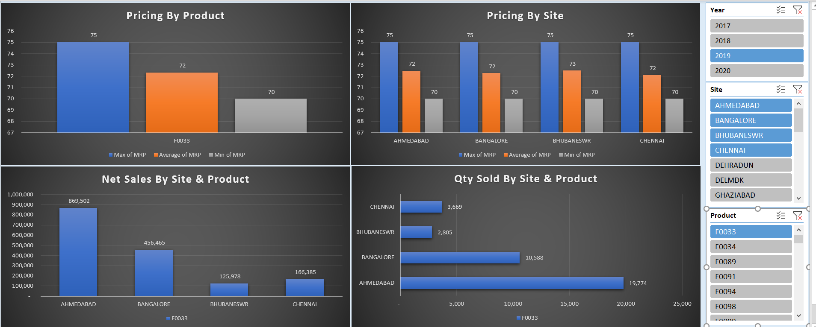
Pricing Analysis

Slide 7
Conclusion
Total net sales is highest in year 2018
F0089 is highest revenue generating product & DELMDK is the highest revenue generating site overall & F0034 is the highest selling product
Based on that we can understand the demand and the inventory can be stocked at the site warehouse
Though F0034 is the highest selling product, F0089 cannibalize its sale due to pricing
F0034 is sold highly at the Ahmedabad site, the pricing can be improved based on average overall price to increase net sales
There is seasonality where the overall sales do well between the month of April to October
Sales can be improved at Kolkata, Dehradun, Gurgaon, Bhubaneshwar sites.
Next Step : Price Optimization of Products based on Pricing Analysis

Slide 8
Thank You

